Slide 1
LE2022 Metabolism Workshop
13 September 2022

Slide 2


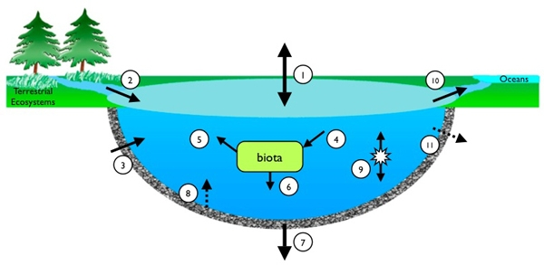
Triumvirate of science

Slide 3
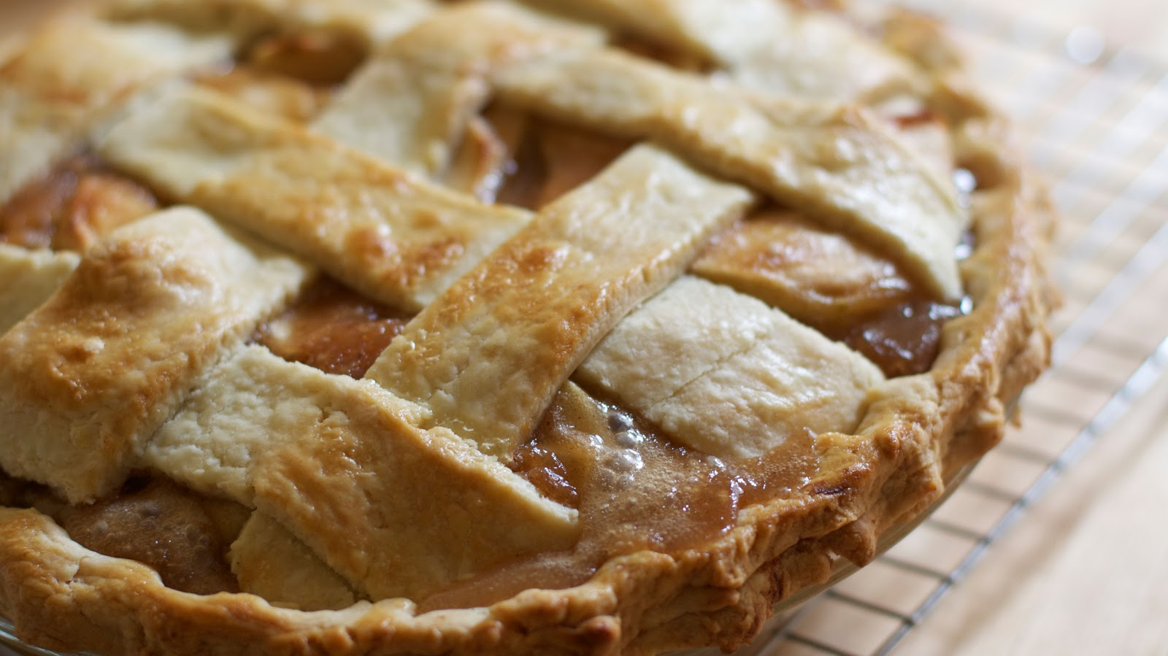
More than the sum of its parts!
(ecosystem scale patterns and
emergent behavior)
Notes:
Both the ingredients and how you put them together; plus, a little luck

Slide 4
Outline
Why process-based models
Building from y = mx + b to metabolism model
Model implementation

Slide 5
Why process-based dynamical models?
A representation of the way the world works
Reproduces a level of realism
Accommodates a variety of data, even if sampled irregularly
Used to infill missing data
Can be used for scenarios that are out of sample
However, models are necessary simplifications and do not explain all the variance in observational data

Slide 6
Key
DOCR: Dissolved organic carbon, recalcitrant
DOCL: Dissolved organic carbon, labile
POC: Particulate organic carbon
TP: Total phosphorus
DO: Dissolved oxygen
DIC: Dissolved inorganic carbon
Water quality metrics as DO, POC, Clarity
A Metabolism Model
State: Boxes are state variables. They have masses (e.g., g) and/or concentrations (e.g., g m⁻³). They are usually observable (e.g., temperature, dissolved oxygen, organic carbon).
grams
atmosphere
atmospheric exchange
DOC_{L,R}
g d⁻¹
Process: Arrows are processes. They are rates (e.g., g d⁻¹) and fluxes (also g d⁻¹). They typically are not observable but rather are inferred from observable changes in states. Processes move mass from one box to another or into/out of the system. Processes are “tuned” as part of fitting the modeled states to observed states. Examples: primary production, respiration, settling, inflow and outflow.
respiration (R)
NPP
(POC_{L},DOC_{L} only)
DO
POC_{L,R}
Load, Export
DIC
P
epilimnion
settling
entrainment (E)
hypolimnion
Model: A process-based model is one way to describe “the way the world works.” Additional characteristics include:
Mass balance: It accounts for all the mass in the boxes. The values in the boxes never match observations perfectly.
Time step: Metabolism models are usually run at time steps of minutes or hours or days, depending on the scale of interest. The time step of the model allows the processes to execute mass transfer in units consistent with the states (e.g., time step (d) x NPP (g d⁻¹) = g).
Complexity: Designed to match the questions and the available data OR use one off-the-shelf to save time.
Transferability: A well-designed and calibrated process-based model is often transferrable from one system to another.
DOC_{L,R}
respiration
DO
POC_{L,R}
P
settling
DIC
respiration
respiration
settling
binding
recycling
release
active
sediments
P_{B},P_{OC}
POC_{L,R}
Permanent Burial

Slide 7
Seems like a long way from our earliest models? But it’s not that far…
e.g., water temperature, nutrients, wind, phytoplankton biomass
e.g., dissolved oxygen, water clarity, organic matter
Y = mX + b
Parameter that is the intercept
Variable we are trying to predict – response, output
Variable we are using to make the prediction – predictor, input,
Parameter (slope) that adjusts the input to try to match the output

Slide 8
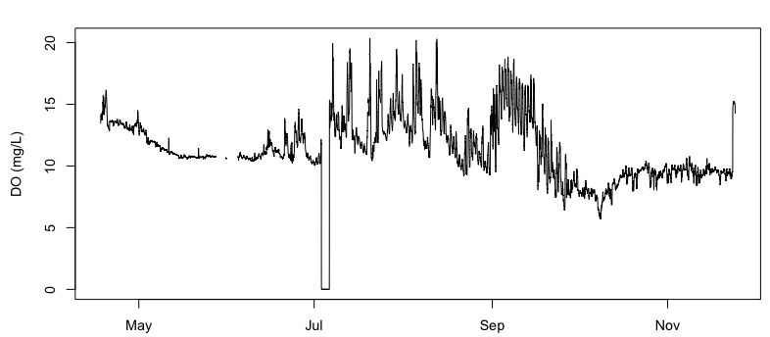
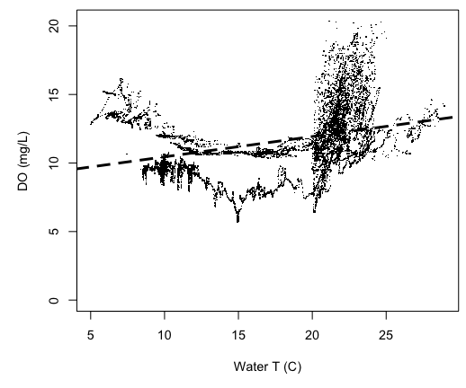
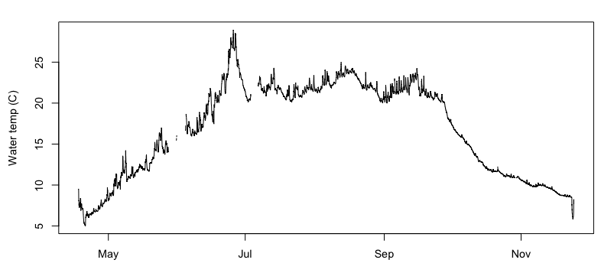
Time buggers our default model
Y = mX + b
Not a good model!
Y
m
b
X

Slide 9
Autocorrelation, innate feature of dynamical systems
Y = mX + b
y_{(t)} = + A₁y_{(t-1)} + B₁u_{(t-1)} + B₀ + Ɛ
Autocorrelation term
Our response variable (e.g., dissolved oxygen) is equal to what it was at the previous time step, multiplied by a parameter (alpha 1) plus the influence of an input variable (driver, e.g., temperature) multiplied by its parameter (beta 1), plus the intercept parameter (beta 0), plus any error.

Slide 10
What does this have to do with a process-based model, such as metabolism?
Process: Gross primary production
Process: Atmospheric exchange – a.k.a. atmospheric flux
dO₂/dt = GPP – R + F_{atm} + A
State change: Change in dissolved oxygen through time
Process: Respiration
Process: All other changes, such as inflow/outflow, mixing
after Odum, H. T. (1956). Primary production in flowing waters 1. Limnology and oceanography, 1(2), 102-117.

Slide 11
In discrete time form…
y_{(t)} = + A₁y_{(t-1)} + B₁u_{(t-1)} + B₀ + Ɛ
These processes have both parameters and data embedded in them.
O_{2(t)} = + O_{2(t-1)} + GPP _{(t-1)} + (-R_{(t-1)}) + F_{atm (t-1)} + A _{(t-1)}
Oxygen at the current time step (t), is equal to what it was at the previous time step (t-1), plus the mass movement of oxygen through a set of processes : gross primary production, (-) respiration, atmospheric exchange and physics.

Slide 12
How do we model processes?
Processes usually connect (a) state variables, or (b) other outside variables (input data) to state variables. Processes have parameters that can be adjusted to help model predictions of state variables match observations.
NPP = f(Phosphorus, Irradiance, Temperature)
Parameter
Input data
Parameter
NPP_{(t)} = C₁ * ([Phosphorus]_{(t)} * Irradiance_{(t)} ) * θ ^{(T(t)-20)}
Process: primary production
Input data
Input data
R = f(OC, Temperature)
Parameter
Parameter
R_{(t)} = C₂ * [OC]_{(t)} * θ ^{(T(t)-20)}
Input data
State variable
Process: respiration

Slide 13
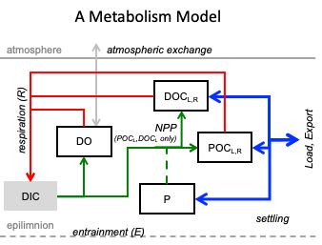
Model implementation
Inputs
Meteorology: Irradiance, wind speed, relative humidity
Hydrology: Discharge
Nutrients: External load if modeling nutrient cycle or water column concentrations if using directly as drivers
Nutrient surrogates: Chlorophyll concentration, phycocyanin fluorescence, water clarity, catchment land-use
Water temperature: If NOT modeling lake physics
Calibration/comparison data
(as many state variables as possible)
Dissolved oxygen: Ideally epi and hypo
Water temperature: Profile IF modeling physics
Nutrients: If modeling nutrient cycles
Dissolved organic C: calibrates the DOC pools
Secchi depth: calibrates DOC and POC pools
Optical characteristics: Calculated directly from organic carbon (DOC and POC as algae) and Secchi depth, with co-variates of temperature and dissolved oxygen
Lake configuration
Morphometry: Hypsometry (area vs depth)
Sediment characteristics: If modeling nutrients
Water residence time: If NOT modeling hydrology

Slide 14

Jump to R

